Slide 1
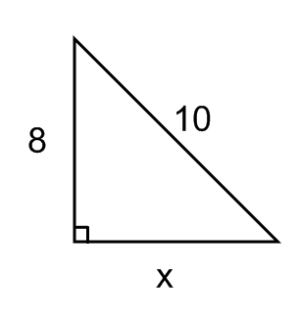
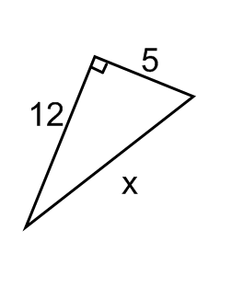
Warm-up
Solve for the missing side.

Slide 2
Intro to Trig Functions
Unit 5 Day 1

Slide 3
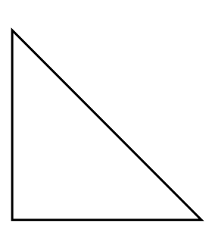
Trigonometry
The relationship between sides and angles of triangles.
Types of questions that can be answered using trig…
Given an angle and one side, find an additional side
Given two sides, find measure of an angle within the triangle.
Sine, Cosine and Tangent

Slide 4
Labeling Right Triangles
Opposite, Adjacent, and Hypotenuse

Slide 5
Right triangle Trig:
Sine: sin θ=
Cosine: cosθ =
Tangent: tan θ =
Soh Cah Toa
13
$$θ$$
5

Slide 6
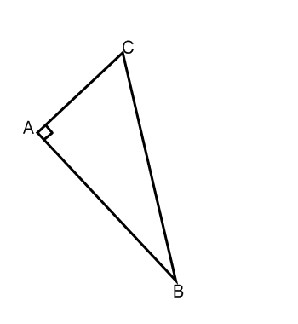

Slide 7
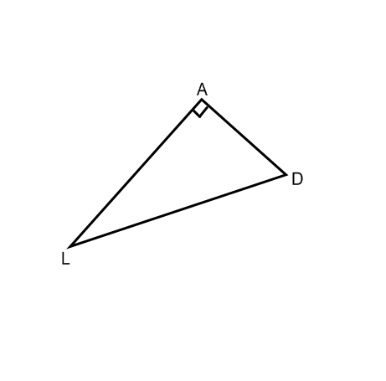

Slide 8
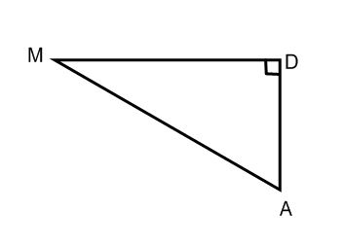

Slide 9
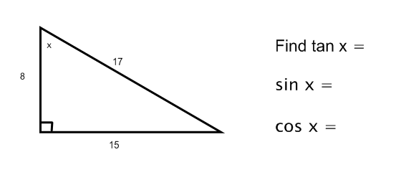
In order to use trig functions in the calculator you MUST have your calculator in DEGREE MODE!!! ☺

