Slide 1
Warm-up
1) What word will you use to help you remember how to find sine, cosine, and tangent for right triangles?
2) Do sides of 15, 25, and 20 correspond to sides of a right triangle? *Prove whether or not they do using algebra and show all of your work. (Hint: draw a triangle!!)

Slide 2
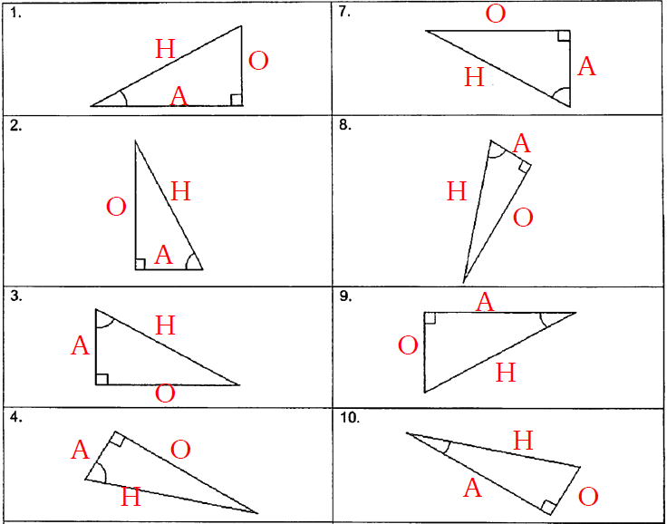
Homework Answers
11) $\{−\frac{3}{2},2\}$
12) $(−1, −1)$

Slide 3
Finding missing sides and angles
Day 2

Slide 4
Solving for missing stuff…
1. Label each leg
2. Write formula
3. Solve to the
nearest tenth
Make sure your calculator is in the correct mode!!! ☺

Slide 8
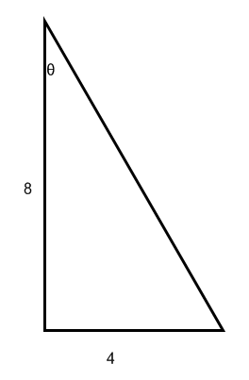
Example 1:
**When solving for angles, use the inverse functions.

Slide 9
Example 2:

