Slide 1
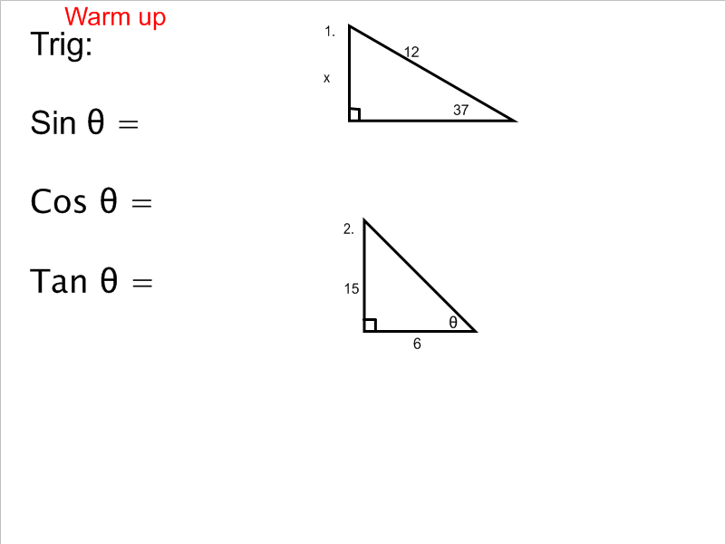
Warm-up
Solve for x.
Solve for Ө.

Slide 2
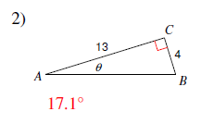
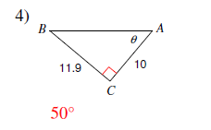
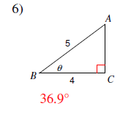
Homework Answers

Slide 3
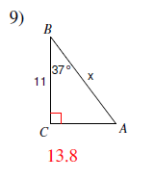
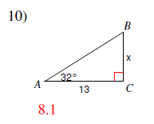
Homework Answers
11) 2.6%
12) In 43 years Harry will have enough money to purchase Mary-Kate’s ring.

Slide 4
Angle of Elevation and Depression
Day 3

Slide 5
Practice

Slide 6
Practice

Slide 7
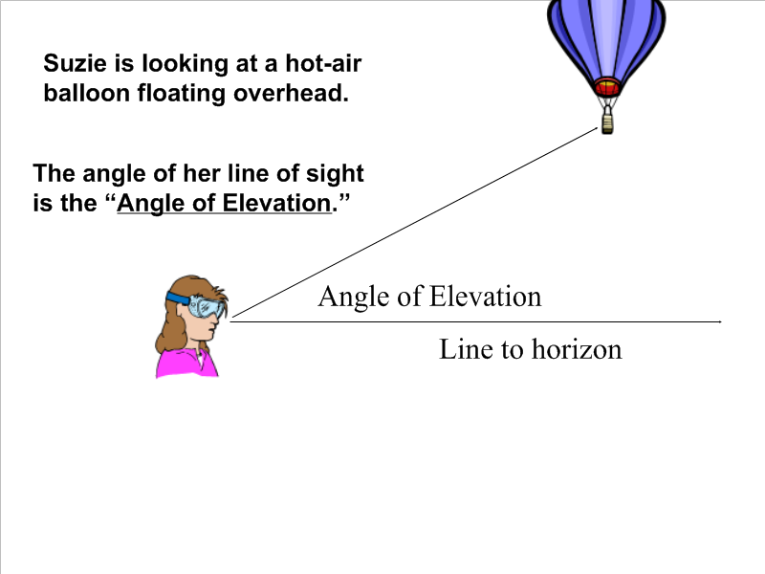
The angle of elevation is the angle formed by
a _________________ and the line of
sight _____________________.

Slide 8
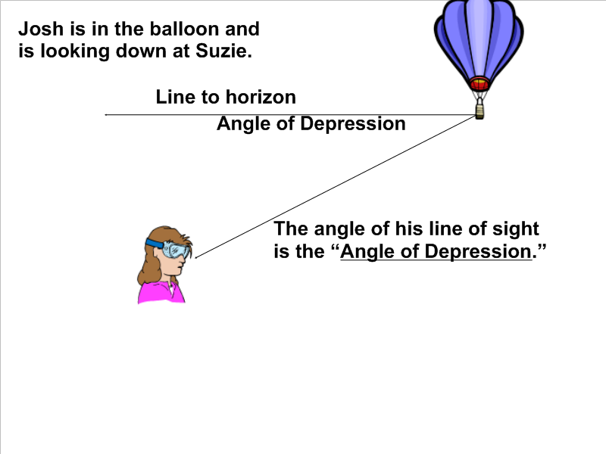
The angle of depression is the angle formed by
a _______________ and the line of sight
____________________.

Slide 9
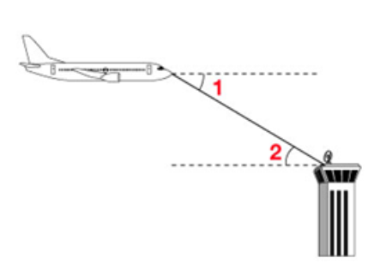
Example:
Describe angle 1 and angle 2 as they relate to the situation shown.

Slide 10
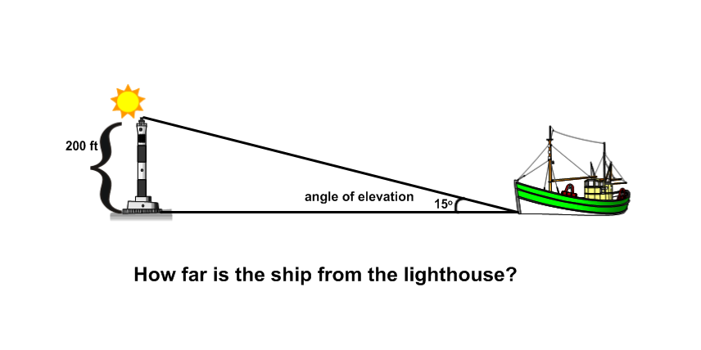
Example
How far is the ship from the light house?

Slide 11
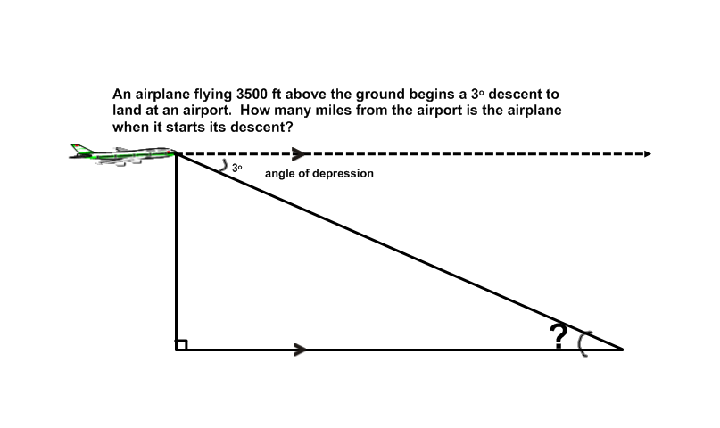
Example:
An airplane flying 3500 ft above the ground begins a 3 degree descent to land at an airport. How many miles from the airport is the airplane when it starts its descent?

Slide 12
You Try!
1) A 24-ft ladder positioned against a wall forms an angle of 75° with the ground.
How high up the wall does the ladder reach?
How far is the base of the ladder from the wall?
2) A wire stretches from the top of an antenna tower to a point on a level ground 18 feet from the base of the tower. The angle between the wire and the ground is 63°. How high is the tower?

