Slide 1
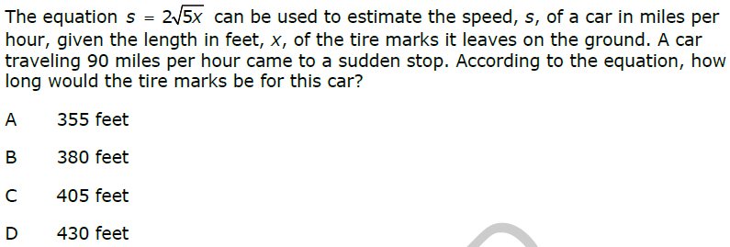
Warm-up

Slide 2
Warm-up
1) Find the number of distinguishable permutations of the letters in the word A. Honolulu B. Gravel
2) A photographer lines up the 11 members of a family in a single line in order to take a photograph. How many different ways can the photographer arrange the family members for the picture?
3) How many different licenses plates are possible with 4 digits and 2 letters if digits and letters cannot be repeated?
4) Suppose you have to use the digits 0-9 to create a four digit sequence, and no numbers are repeated. How many different sequences are possible if the pin cannot start with 0?
5) A group of 8 people was randomly selected from the SGA, which has 10 freshmen, 12 sophomores, 8 juniors, and 11 seniors. Determine the number of different groups that can be created if there are 2 freshmen, 1 sophomore, 3 juniors, and 2 seniors.

Slide 3
Homework Answers
1) 20 2) 3024 3) 55440
4) 70 5) 462 6) 190
7) 6 8) 6 9) 220
10) 120 11) 420 12) 40
13) 120 15) 720

Slide 4
Sample Spaces, Subsets and Basic Probability

Slide 5
Sample Space
Sample Space: The set of all possible outcomes of an experiment.
List the sample space, S, for each of the following:
a. Tossing a coin
S = {H,T}
b. Rolling a six-sided die
S = {1,2,3,4,5,6}
c. Drawing a marble from a bag that contains two red, three blue and one white marble
S = {red, red, blue, blue, blue, white}

Slide 6
Intersections and Unions of Sets
The intersection of two sets (A AND B) is the set of all elements in both set A AND set B.
The union of two sets (A OR B) is the set of all elements in set A OR set B (or both).
Example: Given the following sets, find A and B and A or B
A = {1,3,5,7,9,11,13,15} B = {0,3,6,9,12,15}
A and B = {3,9,15}
A or B = {0,1,3,5,6,7,9,11,12,13,15}
Notes:
Stress that intersection means AND and that union means OR

Slide 7
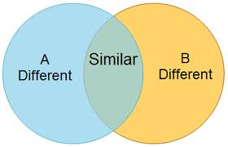
Venn Diagrams
Sometimes drawing a diagram helps in finding intersections and unions of sets.
A Venn Diagram is a visual representation of sets and their relationships to each other using overlapping circles. Each circle represents a different set.

Slide 8
Use the Venn Diagram to answer the questions below:
Factors of 12
1
6 12 2
4
Factors of 16
8
16
A B
What are the elements of set A?
{1,2,3,4,6,12}
What are the elements of set B?
{1,2,4,8,16}
3. Why are 1, 2, and 4 in both sets?

Slide 9
Factors of 12
1
6 12 2
4
Factors of 16
8
16
A B
4. What is A and B?
{1,2,4}
5. What is A or B?
{1,2,3,4,6,8,12,16}
Notes:
Explain to students that the intersection is the overlap of the circles and the union is everything in both circles.

Slide 10
In a class of 60 students, 21 sign up for chorus, 29 sign up for band, and 5 take both. 15 students in the class are not enrolled in either band or chorus.
6. Put this information into a Venn Diagram. If the sample space, S, is the set of all students in the class, let students in chorus be set A and students in band be set B.
7. What is A and B?
8. What is A or B?

Slide 11
S. Students in the class 15
A. Students in Chorus
5
16
B. Students in Band
24
A or B = {45}
A and B = {5}

Slide 12
Complement of a set
The complement of a set is the set of all elements NOT in the set.
The complement of a set, A, is denoted as A^{C} or A’
Ex: S = {…-3,-2,-1,0,1,2,3,4,…}
A = {…-2,0,2,4,…}
If A is a subset of S, what is A^{C}?
A^{C} = {-3,-1,1,3,…}
Notes:
Stress that compliment means NOT

Slide 13
S. Students in the class 15
A. Students in Chorus
16 5
B. Students in Band
24
What is A’? B^{C}?
{39} {31}
What is (A and B)^{C}?
{55}
What is (A or B)^{C}?
{15}

Slide 14
Basic Probability
Probability of an event occurring is:
P(E) = Number of Favorable Outcomes
Total Number of Outcomes
Your answer can be written as a fraction or a %. (Remember to write it as a %, you need to multiply the decimal by 100)
We can use sample spaces, intersections, unions, and complements of sets to help us find probabilities of events.
Note that P(A^{C}) is every outcome except (or not) A, so we can find P(A^{C}) by finding 1 – P(A)
Notes:
Discuss with students that the probabilities of all possible outcomes must add to 1, so the probability of something not happening would be 1 minus the probability of the event occuring.

Slide 15
An experiment consists of tossing three coins.
List the sample space for the outcomes of the experiment.
{HHH, HHT, HTH, HTT, THH, THT, TTH, TTT}
Find the following probabilities:
P(all heads)
1/8 or 12.5%
b. P(two tails)
3/8 or 37.5%
P(no heads)
1/8 or 12.5%
P(at least one tail)
7/8 or 87.5%
How could you use complements to find d?
The complement of at least one tail is no tails, so you could do 1 – P(no tails) = 1 – 1/8 = 7/8 or 87.5%

Slide 16
A bag contains six red marbles, four blue marbles, two yellow marbles and 3 white marbles. One marble is drawn at random.
List the sample space for this experiment.
{r, r, r, r, r, r, b, b, b, b, y, y, w, w, w}
Find the following probabilities:
a. P(red)
2/5 or 40%
b. P(blue or white)
7/15 or 47%
c. P(not yellow)
13/15 or 87%

Slide 17
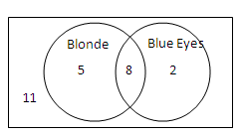
Given the Venn Diagram below, find the probability of the following if a student was selected at random:
16.) P( blonde hair)
13/26 or ½ or 0.5 or 50%
17.) P(blonde hair and blue eyes)
8/26 or 4/13 or 0.308 or 30.8%
18.) P(blonde hair or blue eyes)
15/26 or 0.577 or 57.7%
19.) P(not blue eyes)
16/26 or 8/13 or 0.615 or 61.5%

