Slide 1
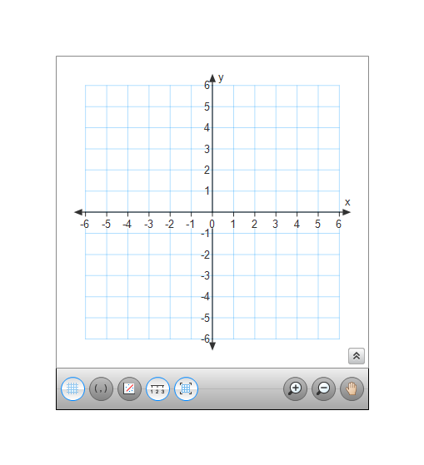
Warm-up ~ Hi!
T(2, -3), A(-1, -2) and J(1, 2)
1. Reflect ΔTAJ over the x - axis.
2. Reflect ΔTAJ over y = x.
3. Reflect ΔTAJ over y = 1

Slide 2
Rotation
A transformation in which a figure is turned about a fixed point, called the center of rotation.
Center of Rotation

Slide 3
A Rotation is an Isometry
Segment lengths are preserved.
Angle measures are preserved.
Parallel lines remain parallel.
Orientation is unchanged.

Slide 4
Discovery Investigation!

Slide 5
90° counter-clockwise rotation
Formula
(x, y) →_____________
A’(2, 4)
A(4, -2)

Slide 6
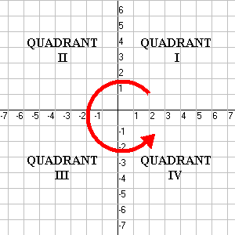
Rotations are always counter-clockwise unless otherwise stated!!!
90⁰: R_{90°}(x, y) = (-y, x)
180⁰: R_{180°}(x, y)= (-x, -y)
270⁰: R_{270°}(x, y)= (y, -x)
90° rotation
( - , +)
(-y, x)
0° rotation
( +, +)
( x, y)
180° rotation
( - , -)
(- x - y)
270° rotation
( + , - )
( y, - x)

Slide 7
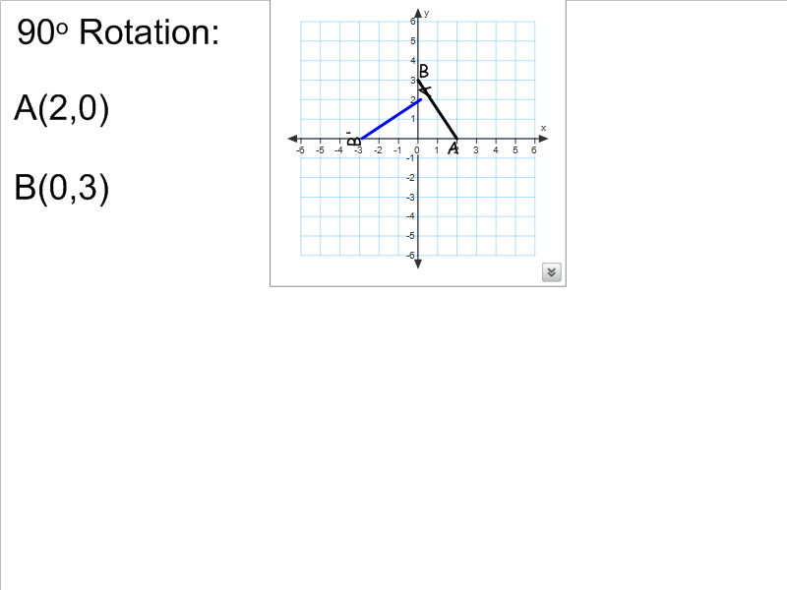

Slide 9
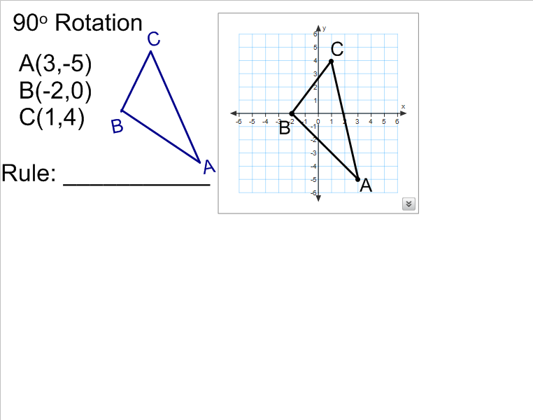

Slide 11
Rotation Example
B(-2, 4)
Draw a coordinate grid and graph:
A(-3, 0)
B(-2, 4)
C(1, -1)
Draw ABC
A(-3, 0)
C(1, -1)

Slide 12
Rotation Example
B(-2, 4)
Rotate ABC 90° clockwise.
Formula
(x, y) → (y, −x)
A(-3, 0)
C(1, -1)

Slide 13
Rotate ABC 90° clockwise.
B(-2, 4)
A’
(x, y) → (y, −x)
A(-3, 0) → A’(0, 3)
B(-2, 4) → B’(4, 2)
C(1, -1) → C’(-1, -1)
B’
A(-3, 0)
C’
C(1, -1)

Slide 14
Rotate ABC 90° clockwise.
B(-2, 4)
A’
Check by rotating ABC 90°.
B’
A(-3, 0)
C’
C(1, -1)

Slide 15
Let’s Talk about Notation Again
Rotations
90⁰: R_{90°}(x, y) = (-y, x) 180⁰: R_{180°}(x, y)= (-x, -y)
270⁰: R_{270°}(x, y)= (y, -x)
Translation T(x, y) = (x + h, y + k)
Line Reflections
x-axis:
y-axis:
y=x:
P(x, y) P’(x, -y) OR r_{x-axis}(x, y) = (x, -y)
P(x, y) P’(-x, y) OR r_{y-axis}(x, y) = (-x, y)
P(x, y) P’(-x, y) OR r_{y = x}(x, y) = (y, x)

Slide 16
D(4, -3)
R_{90°} R_{180°}
r_{x-axis} T(x+4, y-2)
R_{270°} r_{y-axis}
r_{y=x}

Slide 17
G(-3, -4)
R_{90°} R_{180°}
r_{x-axis} T(x+4, y-2)
R_{270°} r_{y-axis}
r_{y=x}

