Slide 1
Warm-up: Find the image of (2,3) under each transformation.
T (x, y)=(x-6, y-2) 2. r_{y-axis}
3. r_{y = 6} 4. R _{0,90⁰}

Slide 2
Homework Answers

Slide 3
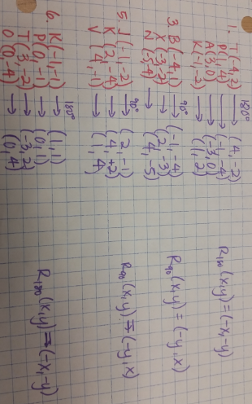

Slide 5
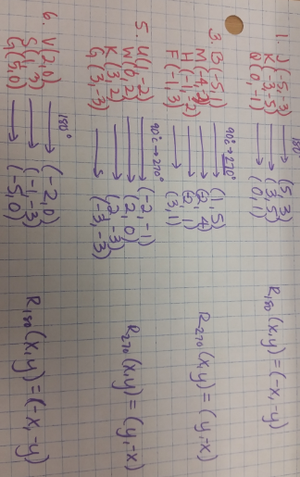

Slide 6
Let’s Talk about Notation Again
Dilations: D_{k}(x, y) = (kx, ky)
Rotations
90⁰: R_{0,90°}(x, y) = (-y, x) 180⁰: R_{0,180°}(x, y)= (-x, -y)
270⁰: R_{0,270°}(x, y)= (y, -x)
Translation: T(x, y) = (x + h, y + k)
Line Reflections
x-axis: y-axis:
y=x:
r_{x-axis}(x, y) =(x,-y)
r_{y-axis}(x, y) =(-x,y)
r_{y = x}(x, y) =(y,x)

Slide 7
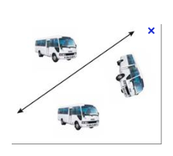
Apply Compositions of Transformations

Slide 8
Vocabulary
When two or more transformations are combined to form a new transformation, the result is called a composition of transformations

Slide 9
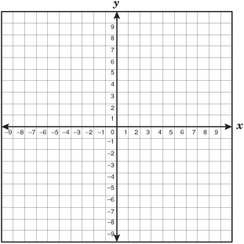
Example 1
The vertices of triangle ABC are A (3,2), B(6,3), and C (7, 1). Find the image of triangle ABC after the composition.
Translation: (x,y)….(x-12, y)
Reflection: over the x-axis

Slide 10
Example 2
The vertices of triangle PQR are P (2,6), Q(4,-2), and C (-3, -3). Find the image of triangle PQR after the composition.
Translation: (x,y)….(x+4, y)
Reflection: in the x-axis

Slide 11
Example 3
The endpoints of RS are R (1, -3) and S(2, -6).
Graph the image of RS after the composition.
Reflection: in the y-axis
Rotation: 90º about the origin

Slide 12
Example 4
The endpoints of MN are M (-2, 1) and N(3, 4). Graph the image of MN after the composition.
Reflection: in the line y=x
Rotation: 180º about the origin

