Slide 1
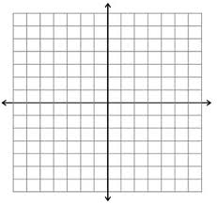
Warm-up
1) Write the equation of the line passing through (4,5)(3,2) in:
Slope Intercept Form:
Standard Form:
Graph:
Find intercepts.

Slide 2
Lines of Best Fit

Slide 3
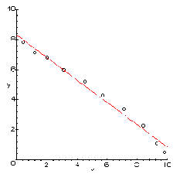
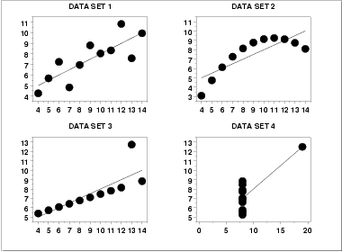
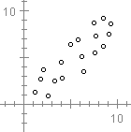
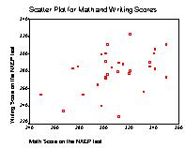
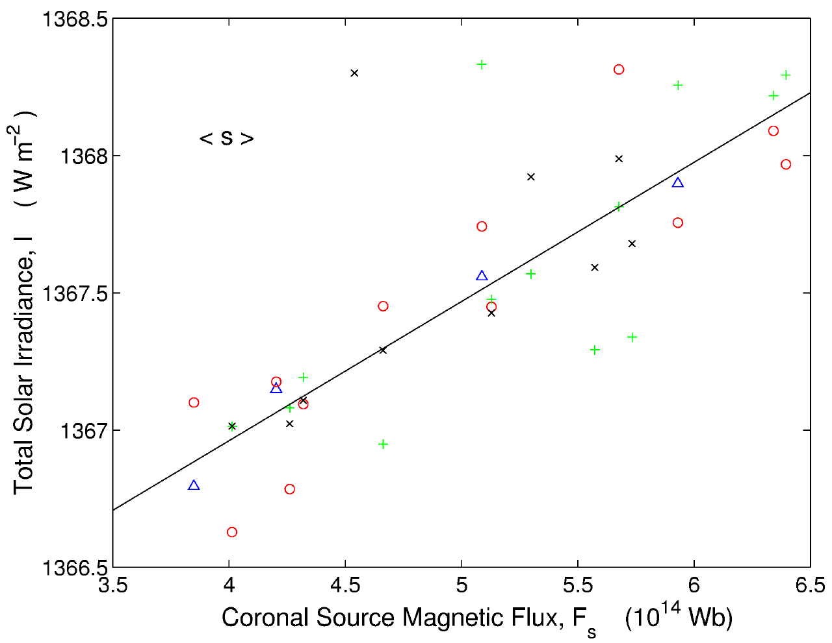
SCATTER PLOTS

Slide 4
SCATTER PLOT
A graph used to determine whether there is a relationship between paired data.
These relationships may be linear, quadratic, cubic, quartic, logarithmic, exponential, etc.
Used to make predictions.
Linear patterns can be described according to the type of correlation.

Slide 5
SCATTER PLOT
A graph used to determine whether there is a relationship between paired data.
These relationships may be linear, quadratic, cubic, exponential, etc.
Used to make predictions.
Linear patterns can be described according to the type of correlation.

Slide 6
Using the calc to find a line of best fit
Enter data into L1 and L2
Press STAT CALC and then 4 LinReg(ax+b) Enter Enter
x | y
1 | 15
2 | 21
3 | 22
4 | 26
5 | 28
What does this screen mean?
The equation of the line of best fit is ____________________
Correlation coefficient is _____ so __________.
Use the data/line of best fit to make predictions:
What is the value of y when x=5.2 _______________
What is the value of x when y=10 _______________

Slide 7
1) The table shows the cost of visiting a working ranch for one day and night for different numbers of people.
Can the situation be modeled by a linear equation? Explain.
What is the slope and what does it represent?
Write an equation that gives the cost as a function of the number of people in the group.
Number of People | 4 | 6 | 8 | 10 | 12
Cost (dollars) | 250 | 350 | 450 | 550 | 650

Slide 8
2) The table shows the cost of a catered lunch buffet for different numbers of people.
a) What is the slope and
what does it represent?
b) Write an equation that gives the cost of the lunch buffet as a function of the number of people attending.
c) What is the cost of a lunch buffet for 120 people?
Number of People | Cost (Dollars)
12 | 192
18 | 288
24 | 384
30 | 480
36 | 576
42 | 672

Slide 9
4) The table shows the number of active woodpecker clusters in a part of the De Soto National Forest in Mississippi.
a) Make a scatterplot of the data. Represent the x-axis as the number of years since 1990.
b) Find the slope and describe what it represents.
c) Write an equation that models the number of active clusters as a function of the number of years since 1990.
d) Use the equation to determine the number of active clusters in the year 2010.
Year | 1992 | 1993 | 1994 | 1995 | 1996 | 1997 | 1998 | 1999 | 2000
Active Clusters | 22 | 24 | 27 | 27 | 34 | 40 | 42 | 45 | 51

Slide 10
5) The table shows the weight of an alligator at various times during the feeding trial.
a) Make a scatterplot of the data.
b) Find the slope and describe what it represents.
c) Write an equation of the best fitting line.
d) Use the equation to predict the weight of this alligator at week. 52.
Weeks | 0 | 9 | 18 | 27 | 34 | 43 | 49
Weight (pounds) | 6 | 8.6 | 10 | 13.6 | 15 | 17.2 | 19.8

Slide 11
6) The table shows the duration of several eruptions of the geyser Old Faithful and the interval between eruptions.
a) Make a scatterplot of the data and draw a line of best fit.
b) Write an equation that models the interval as a function of an eruption’s duration.
c) Predict the interval between geysers for a duration of 6 minutes.
Duration (min) | 1.5 | 2 | 2.5 | 3 | 3.5 | 4 | 4.5 | 5
Interval (min) | 50 | 57 | 65 | 71 | 76 | 82 | 89 | 95

