Slide 1
DAY 1 – Warm-Up
Write a quadratic in standard form with zeroes at 3 and -2.
Solve: 2x² – 3x = -4

Slide 2
Radical and Exponential Functions
UNIT 3

Slide 3
Remember your exponent rules??
RULE!!!
Negative Exponents

Slide 4
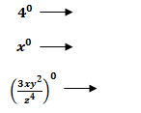
Remember your exponent rules??
RULE!!!
Raising to the Power of Zero

Slide 5
Remember your exponent rules??
RULE!!!
Multiplication with Exponents

Slide 6
Remember your exponent rules??
RULE!!!
Division with Exponents

Slide 7
Remember your exponent rules??
RULE!!!
Power Rule

Slide 8
Work on the Investigations/Activities with your partner! ☺ Happy Early Release Day! Be sure you understand all of this when you come in on Monday!!!!!
Check in with Ms. Overton after you and your partner finish each section!!!! You want to have correct notes for when you go to study ☺
**PS…I’m so ready for SUMMER!!

Slide 9
Before we begin today’s lesson, how much do you remember about exponents? Use expanded form to write the rules for the exponents.

Slide 12
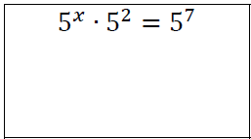
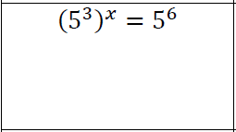
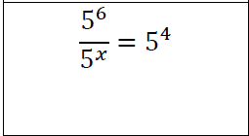
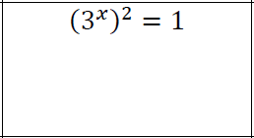
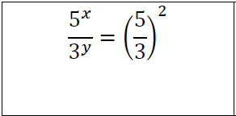
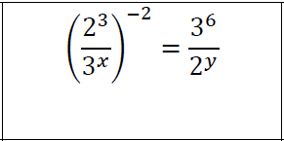
Solve for the given variable(s)

Slide 13
Radical Vocabulary
Definition of Square Root: For any real numbers a and b if a²= b, then a is a square root of b.
Definition of nth Root: For any real numbers a and b, and any positive integer n, if a^{n}=b, then a is an nth root of b.

Slide 14

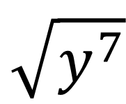

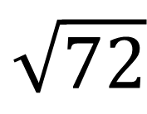
EXAMPLES!
1. 2. 3. 4.
$$\sqrt{9}$$
$$\sqrt{72}$$
$$\sqrt{x^{4}}$$
$$\sqrt{y^{7}}$$

Slide 15
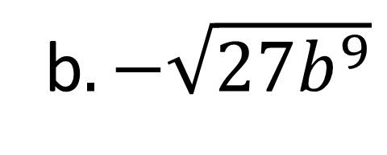
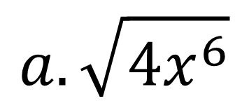
Simplifying Radical Expressions
$$a. \sqrt{4x^{6}}$$
b$. −\sqrt{27b^{9}}$
c$. 3\sqrt{16x^{8}y^{10}z^{21}}$

Slide 16
You Try!
$$a. \sqrt{75a^{3}b^{6}}$$
b$. −4\sqrt{24x^{7}y^{14}}$

